Slide 1
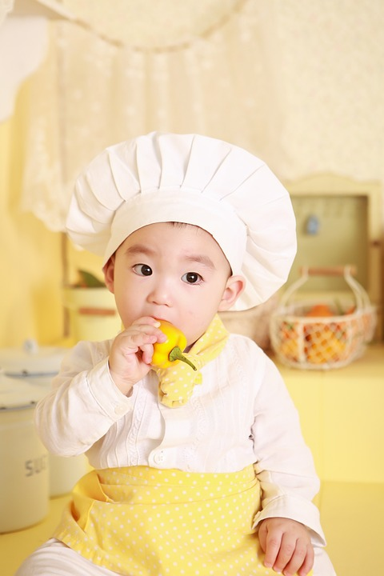
Food around Asia
Matrix
Kite
William
Lucy
Phoo Pwint

Slide 2
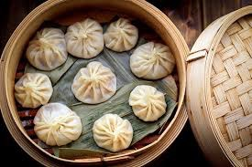
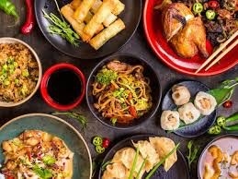
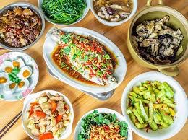
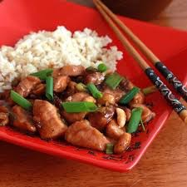
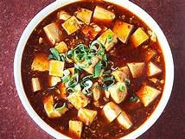
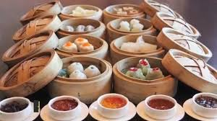
CHINESE FOOD

Slide 3
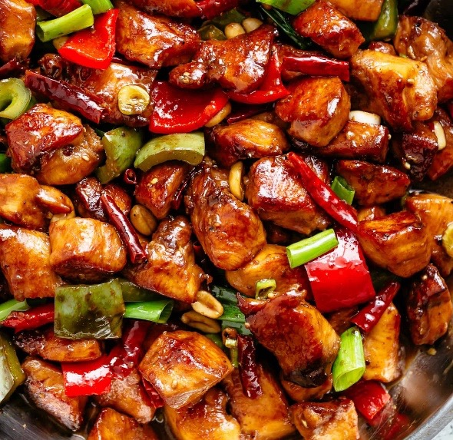
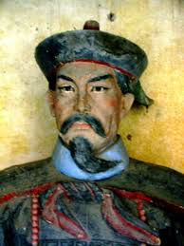
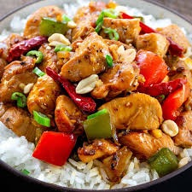
Kung Pao
Chicken
-Ingredient
stir-fired chicken with sichuan pepper corns
-Taste
crisp-tender
-Location
restaurants all over the china
-named after Ding Baozhen

Slide 4
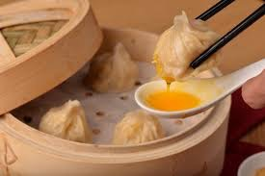
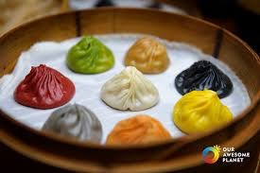
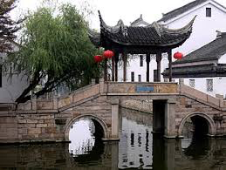
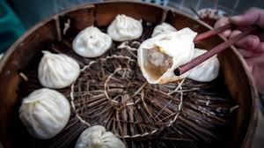
XIAO LONG BAO
-Ingredient
mixed meat and spicy soup
-Taste
burning and explosion flavour
-Location
Shanghai and Wuxi
- Jangnan region.

Slide 5
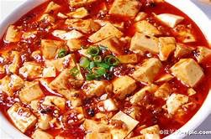
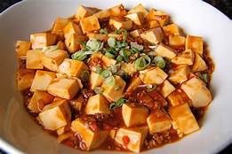
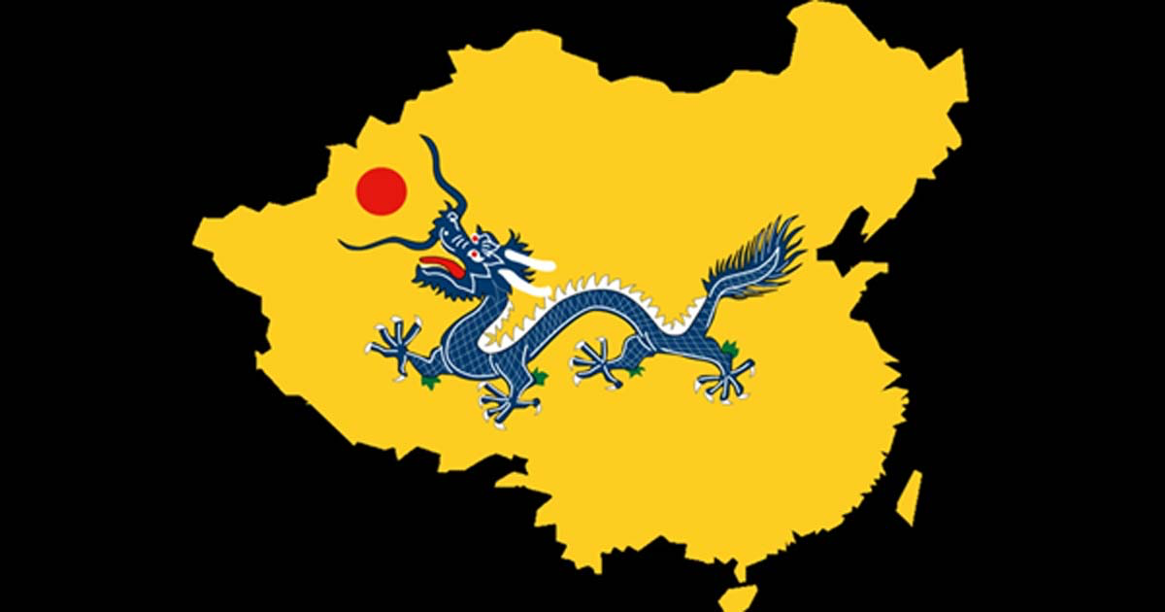
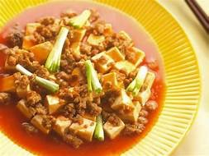
-Ingredient
silken tofu,minced meat
-Taste
unique with 5 tastes
-Location
restaurants all over the china
Ma Po Tofu
Qing
Dynasty (1644-1911)

Slide 6

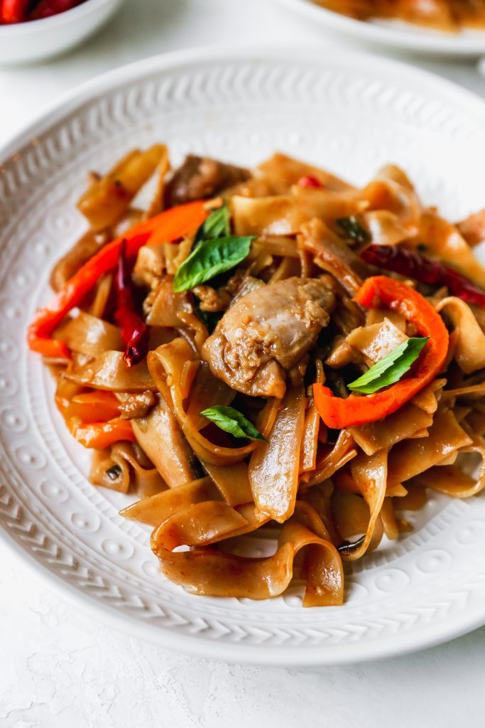
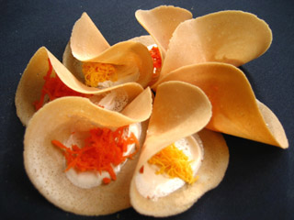
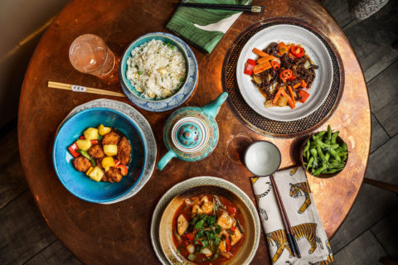
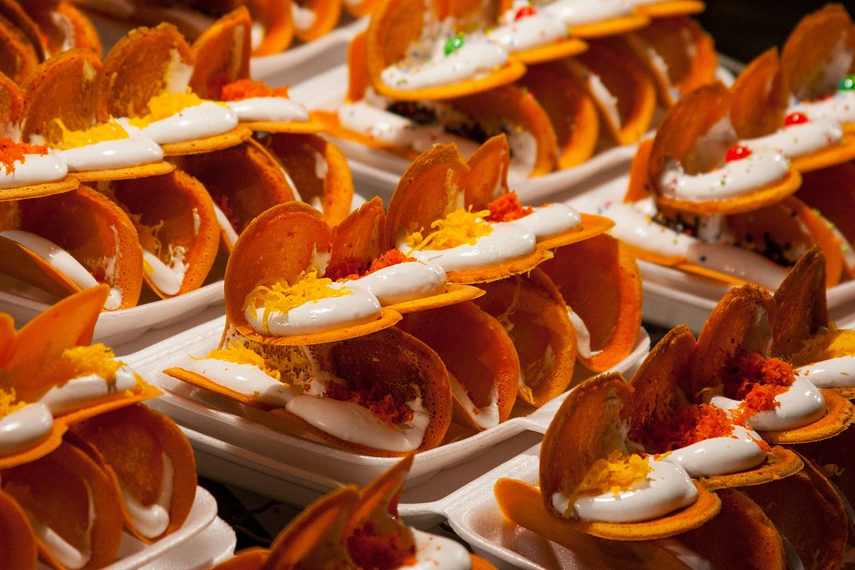
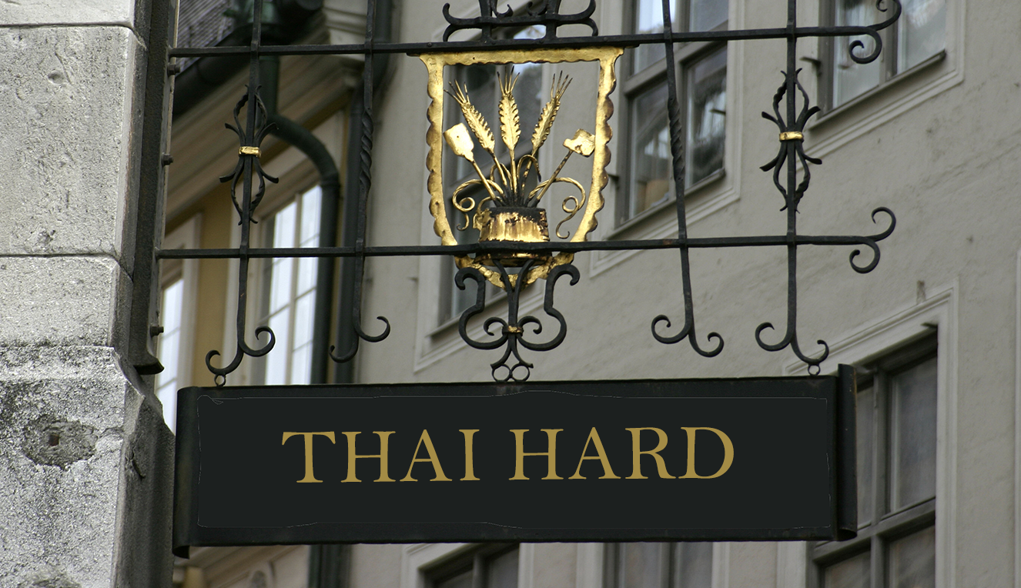
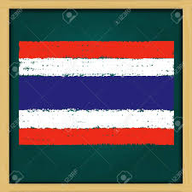
THAI FOOD

Slide 7

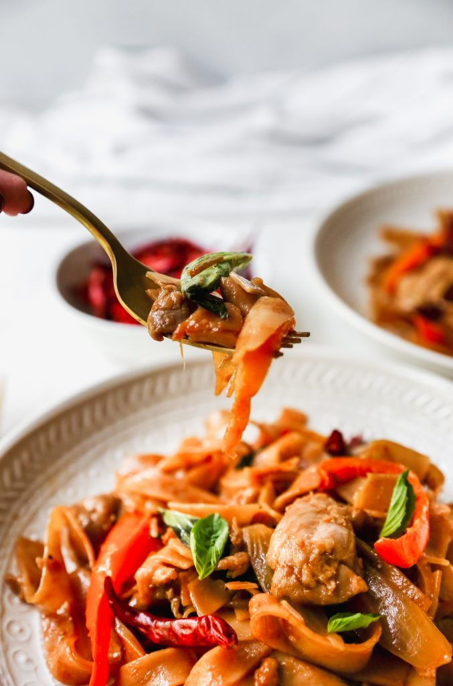
Drunken Noodles
Known as Pad Kee Mao
Spicy enough to make you feel drunk
Taste : Surprisingly thick creating a rubbery chewy texture

Slide 8
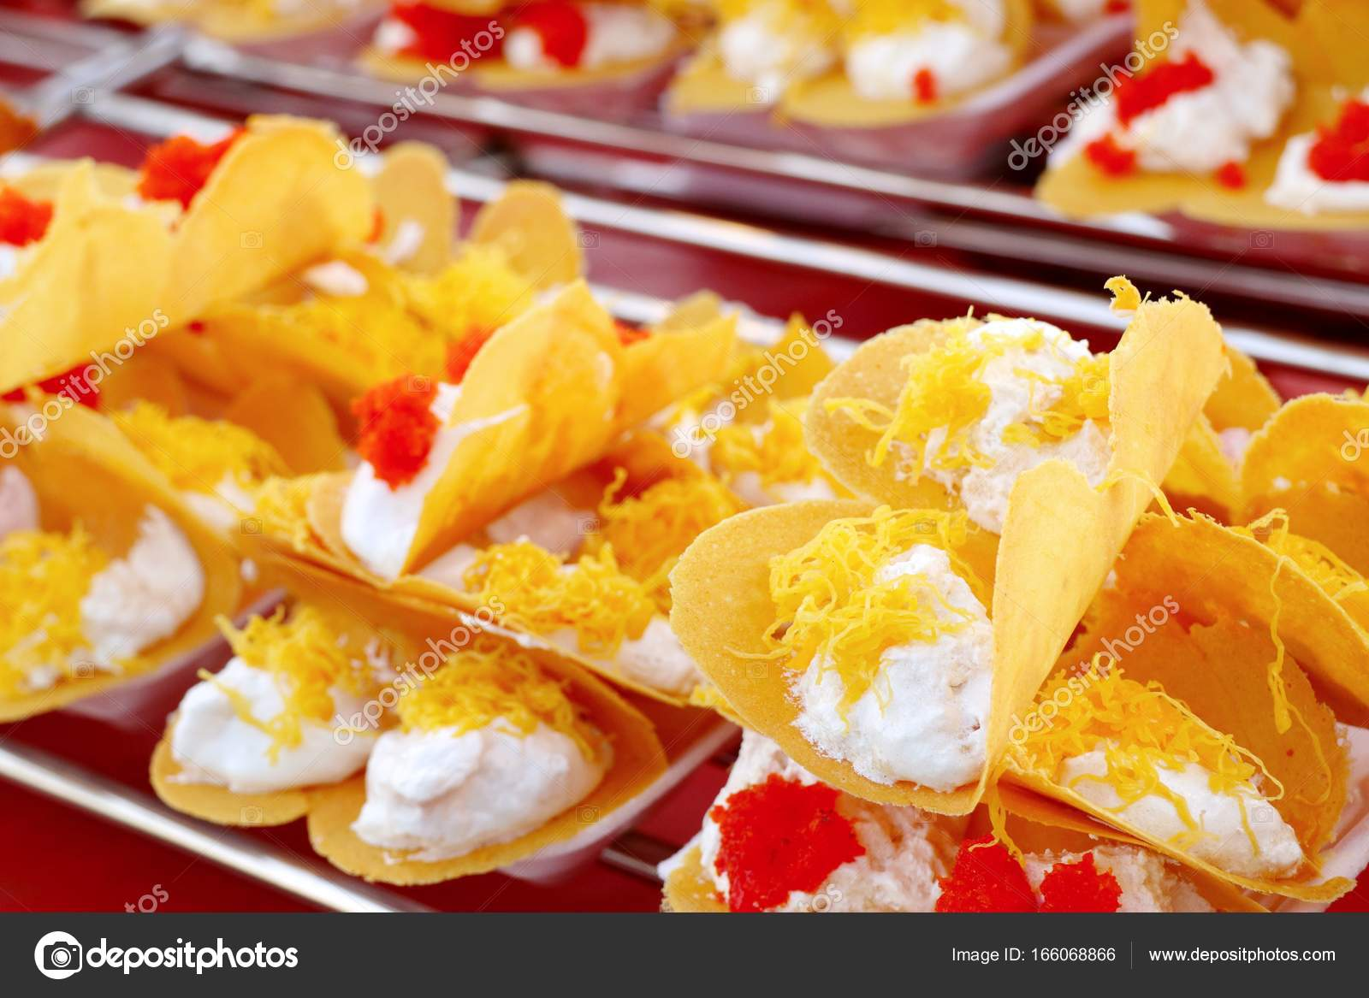
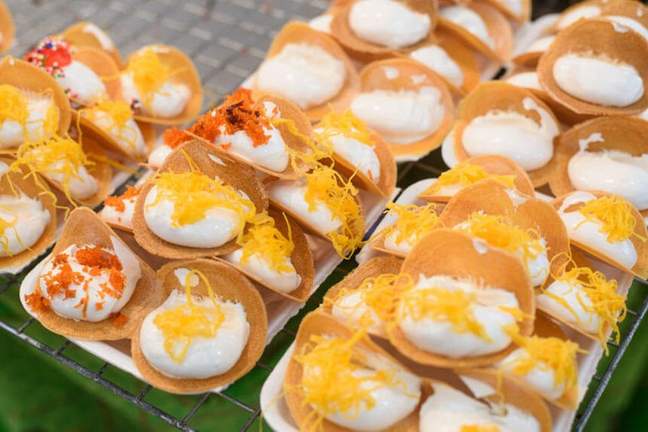
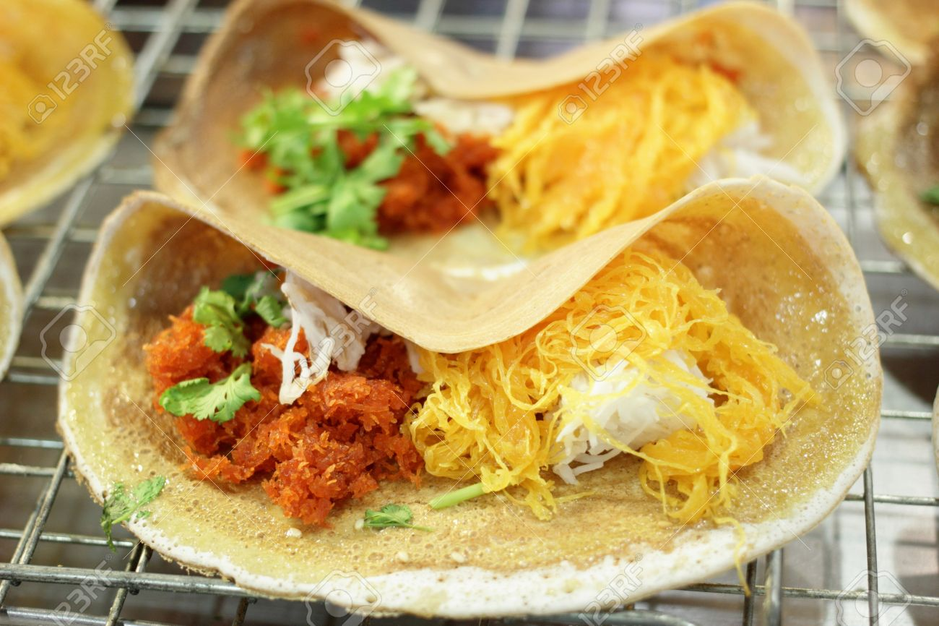
Thai Crispy Crepe
Also called Khanom Buang
Taco looking snack with crunchy texture
Pancake batter stuffed with sweet or savory cream

Slide 9
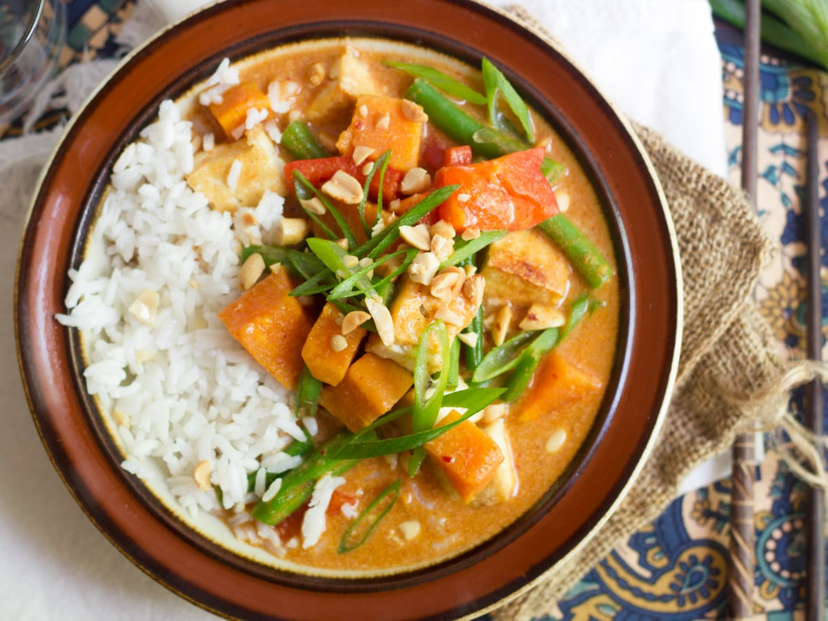
Massaman curry
Rich , relatively mild Thai curry
Has Persian influence and originated in the south of Thailand
Derived from Indian curry

Slide 10
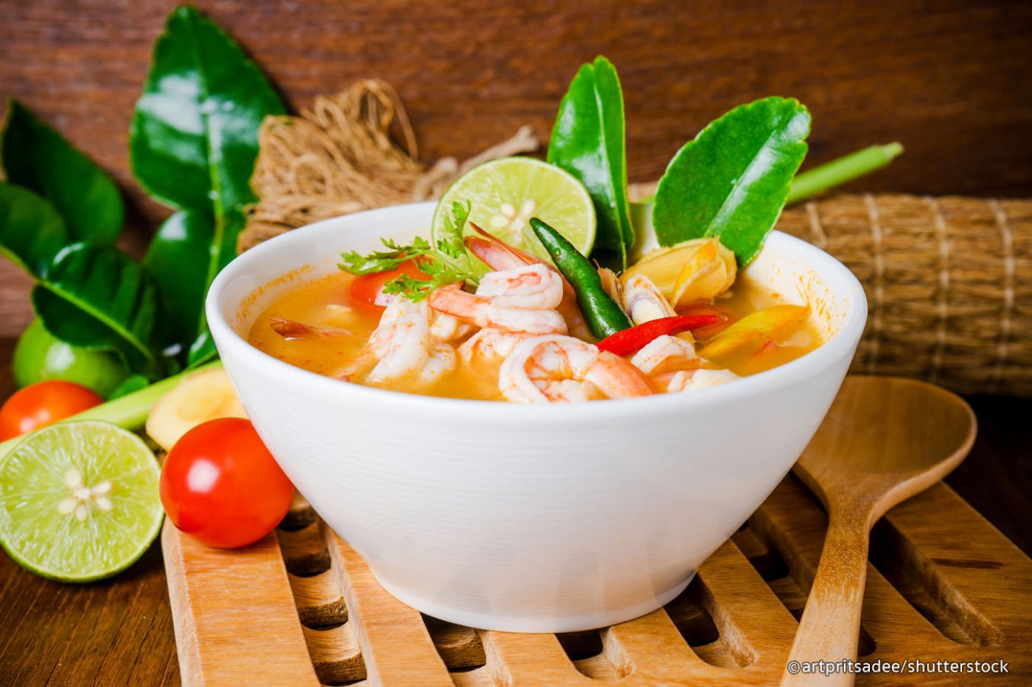
Tom yum goong
spicy shrimp soup
Most famous Thai soup
Very healthy
Reduces heart disease , increases immunity and relieves coughing and nausea

Slide 11
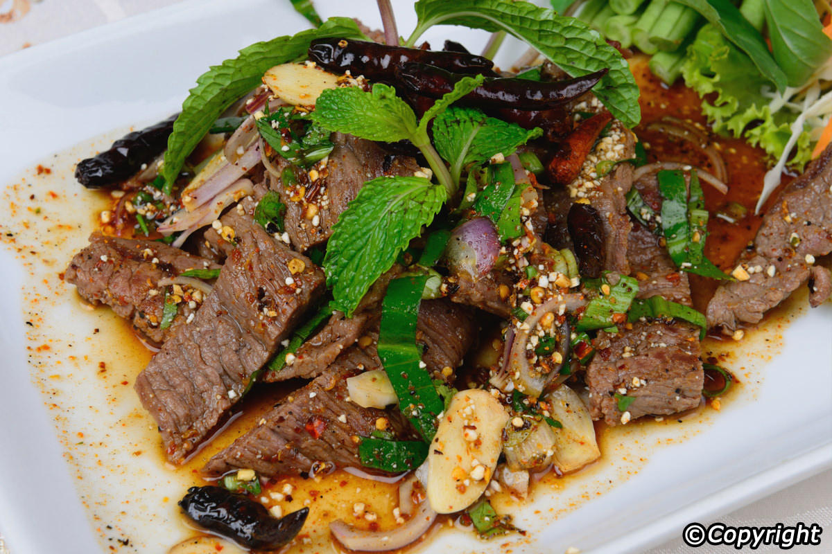
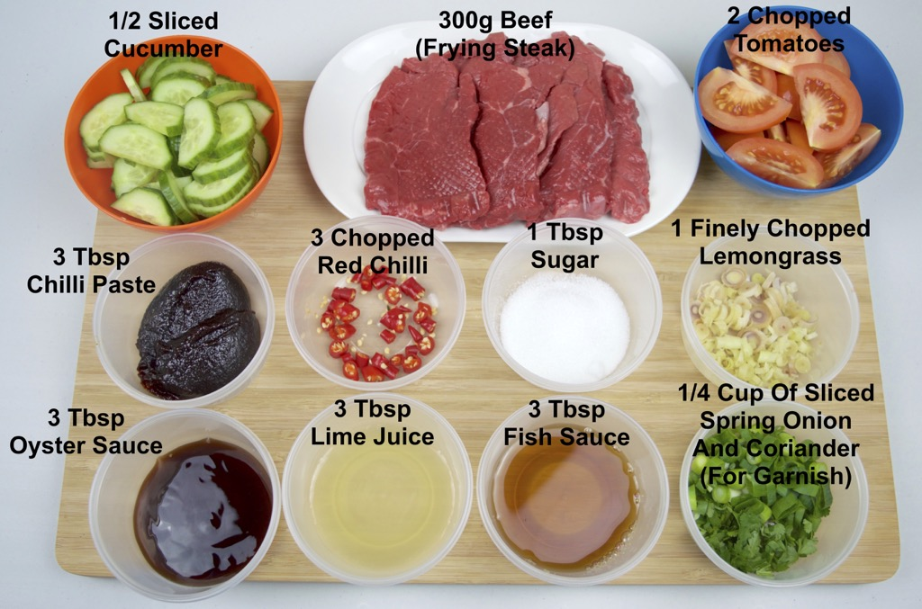
Yum Nua
Thai Beef Salad
Best served with jasmine rice or sticky rice to soak up the sauce
Can also eat as quick light snack

Slide 12
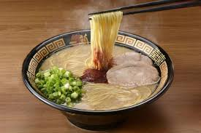
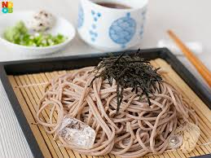
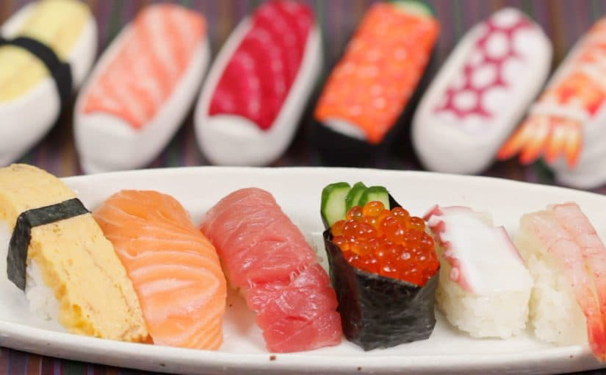
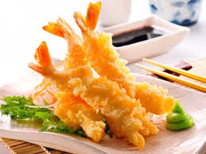
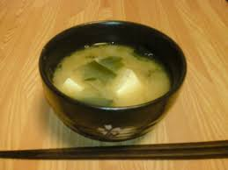
JAPANESE FOOD

Slide 13
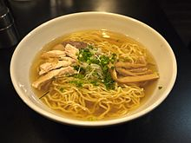
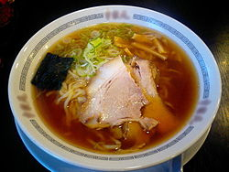
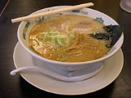
Ramen
Ingredients
Noodle,
Chicken or Pork soup
Boiled Egg
Nori
Some other toppings
Ramen means “pulled noodles”.
Originated in the early 1600s.
Popularity increased in 1900s.

Slide 14
sashimi
Two types of sashimi
Rich flavor & light flavor
beautifully prepared with colorful seafood
Best with sauce
-Sashimi means “pierced body”
It is
“raw sliced fish”

Slide 15
Sake
Sake brewers are called toji
Sake means “Rice wine”
-18-20% ABV

Slide 16
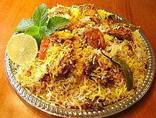
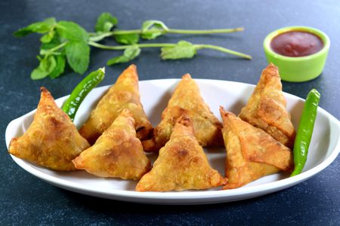
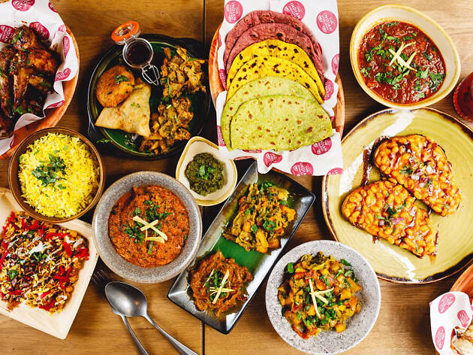
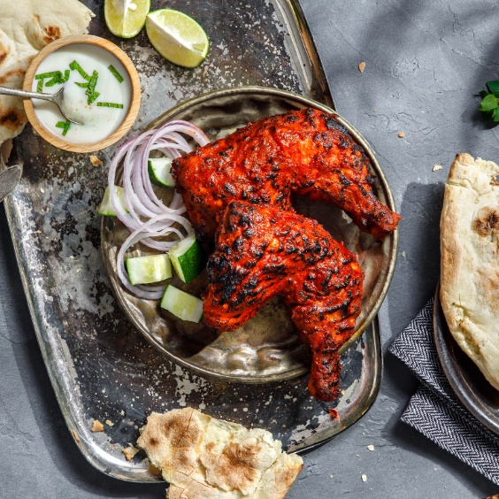
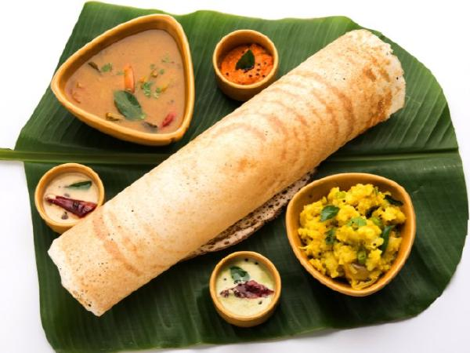
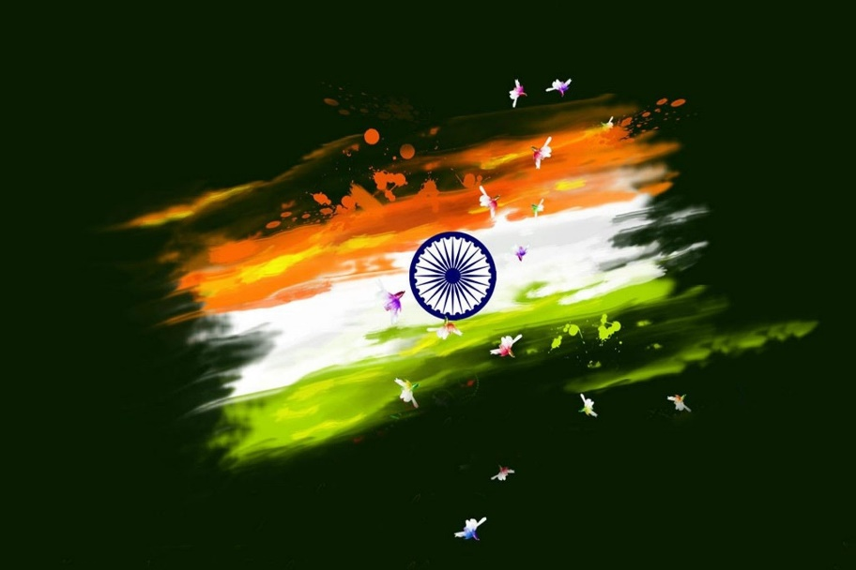
Indian Food

Slide 17
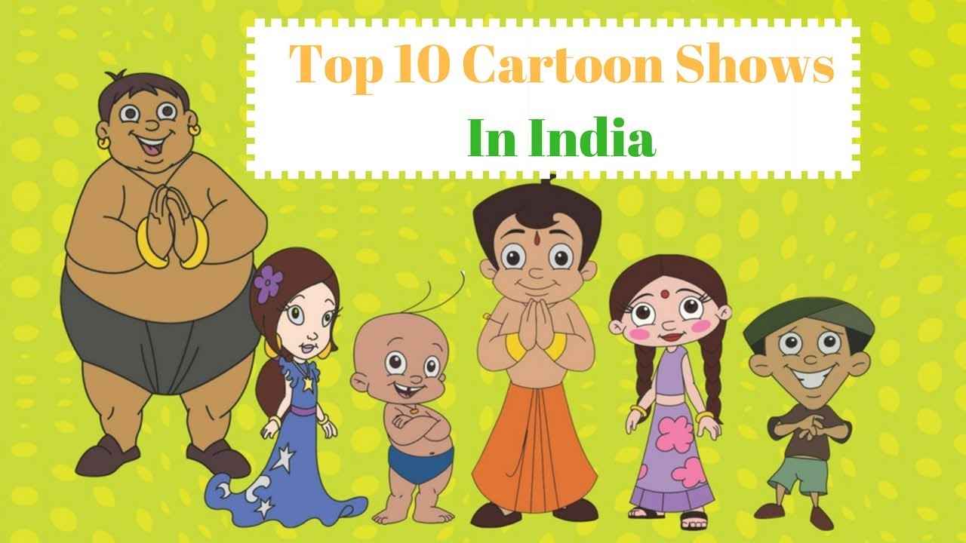
Namastae !

Slide 18
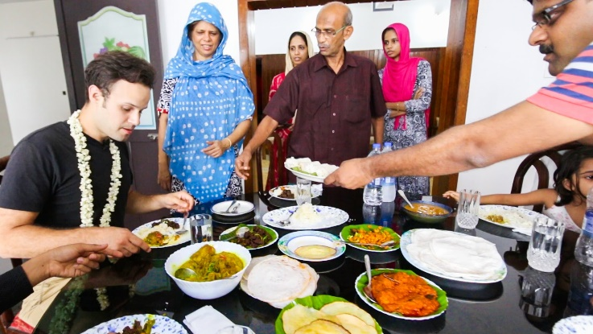
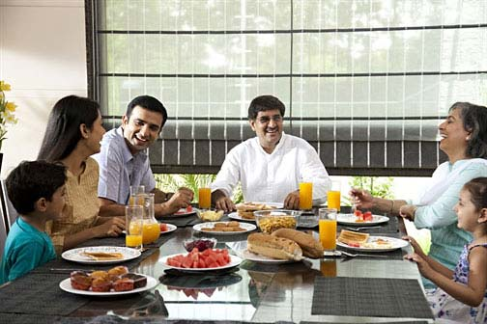
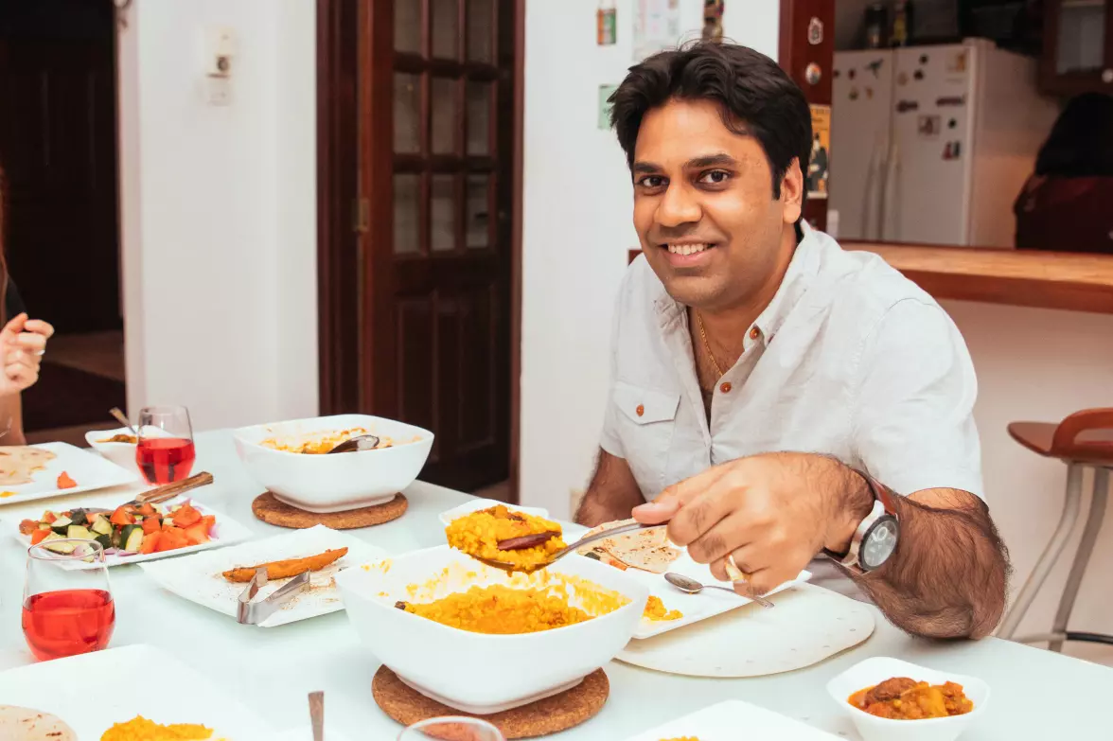







Slide 19


Biryani
-is a mixed rice dish with its origins among the Muslims of the Indian subcontinent.
Ingredients
It is made with Indian spices, rice, meat (chicken, goat, beef, lamb, prawn, or fish), vegetables or eggs.

Slide 20


Dosa
-is a cooked flat thin layered rice batter,
originating from the Indian subcontinent, made from a fermented batter.
Its main ingredients are rice and black gram ground together in a fine, smooth batter with a dash of salt.

Slide 21


Samosa
is a fried or baked dish with a savory filling and may take different forms, including triangular, cone….
Ingredients
It is filled with spiced potatoes, onions, peas, meat, or lentils.

Slide 22


